Slide 1
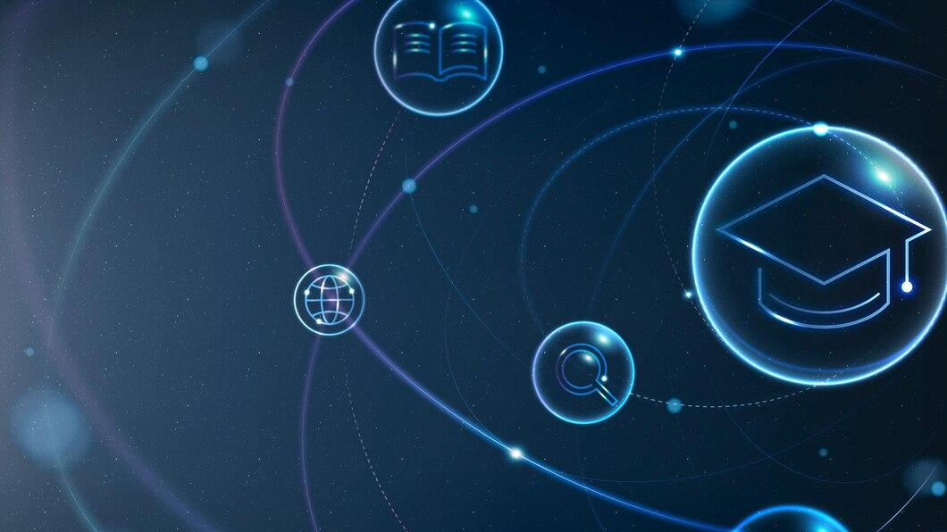





AI CHATBOT USING CHATGPT - OPEN AI API
Student Details
Name: SUJATHA
NM Id: au2021107025
College Name: COLLEGE OF ENGINEERING GUINDY

Slide 2

Course Outline
AI CHATBOT USING CHATGPT - OPEN AI API
Abstract
Problem Statement
Aims, Objective & Proposed System/Solution
Project architecture
Algorithm
Future Scope
Conclusion
Reference

Slide 3
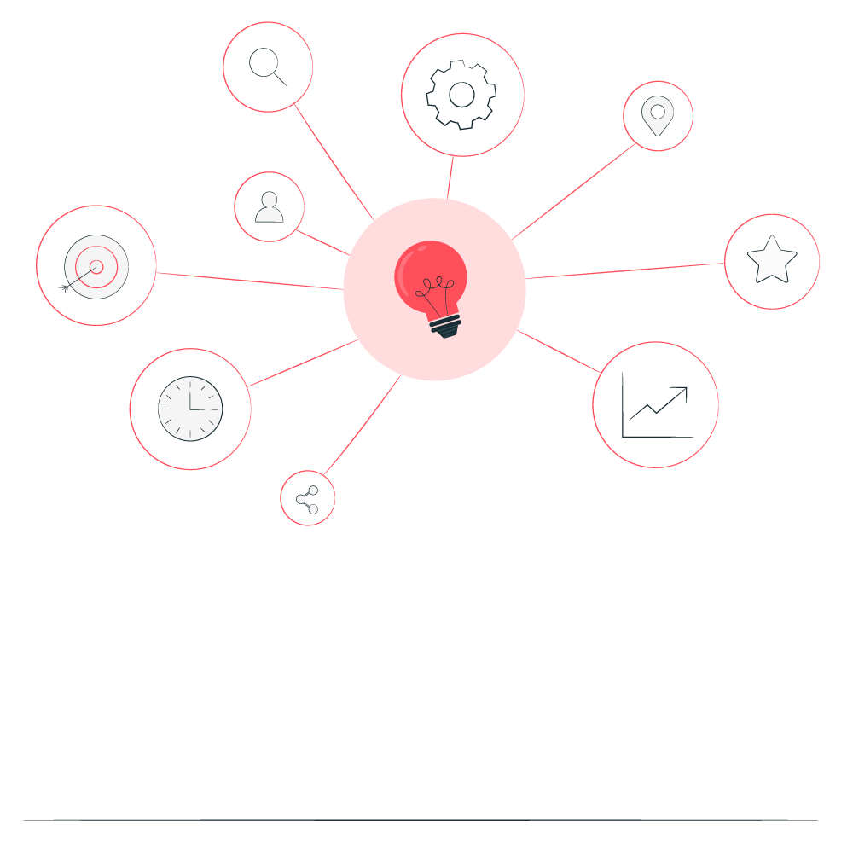

AI CHATBOT USING CHATGPT - OPEN AI API
Abstract
Artificial intelligence (AI) technologies are revolutionizing various aspects of human life. This project report delves into the development of an AI chatbot using the OpenAI API, focusing on leveraging the ChatGPT model to facilitate engaging and informative conversations. The objective of the project was to create an intelligent conversational agent capable of understanding user queries and providing relevant responses in real-time. The development process began with an overview of the OpenAI API and its significance in advancing conversational AI technologies. By obtaining access to the API and configuring the necessary parameters, we established the foundation for implementing our chatbot solution.

Slide 4


AI CHATBOT USING CHATGPT - OPEN AI API
Problem Statement
This project seeks to address the aforementioned challenges by designing and implementing an AI chatbot using the OpenAI API and ChatGPT model. The objective is to create a chatbot proficient in understanding user queries, generating contextually relevant responses, and maintaining a coherent dialogue flow. Moreover, the chatbot must adhere to ethical standards, ensuring fairness, privacy, and responsible AI deployment.

Slide 5

AI CHATBOT USING CHATGPT - OPEN AI API
Aim and Objective
Aim: The primary objective of this Final Seminar is to present the outcomes and advancements made in the project “.AI Chatbot using chatgpt - open AI API” “

Slide 6
AI CHATBOT USING CHATGPT - OPEN AI API
Objectives
1. Develop an Intelligent Conversational Agent: Create a chatbot powered by OpenAI's ChatGPT model that can engage in natural language conversations with users, providing accurate and contextually relevant responses across various topics and domains.
2. Enhance User Experience and Interaction: Focus on improving the user experience by implementing features such as context management, personalized responses, and multi-turn dialogue capabilities, ensuring seamless and engaging interactions with the chatbot.

Slide 7
AI CHATBOT USING CHATGPT - OPEN AI API
Proposed Solution
The suggested remedy entails creating an AI chatbot that will employ the OpenAI API and the GPT-3.5 model in particular to enable intelligent text-based user chats. The chatbot is designed to meet the increasing need for automated conversational agents that can assist, inform, and engage users in real time across multiple domains. This API facilitates text generation based on user input, enabling the chatbot to respond intelligently to a wide range of queries and prompts. The chatbot implements mechanisms for managing conversations, including maintaining a conversation history to provide context for generating responses.
Notes:
7

Slide 8
AI CHATBOT USING CHATGPT - OPEN AI API
Project architecture
User Interaction Layer
Chatbot Logic Layer
Open AI API Integration
Feedback and Improvement Loop
Response Delivery Layer
Notes:
8

Slide 9
AI CHATBOT USING CHATGPT - OPEN AI API
Algorithm
pip install openai
import openai
openai.api_key = 'your_openai_api_key’
def chat_with_gpt(prompt):
response = openai.Completion.create(
engine="text-davinci-003",
prompt=prompt,
max_tokens=50
)
return response.choices[0].text.strip()
def main():
print("AI Chatbot: Welcome to the Chatbot!?")
print("You can start chatting. Type 'exit' to quit.")
while True:
Notes:
9

Slide 10
AI CHATBOT USING CHATGPT - OPEN AI API
user_input = input("You: ")
if user_input.lower() in ['exit', 'quit', 'bye']:
print("AI Chatbot: Goodbye!")
break
prompt = f"You: {user_input}\nAI Chatbot:"
response = chat_with_gpt(prompt)
print(response)
if __name__ == "__main__":
main()
Notes:
10

Slide 11
AI CHATBOT USING CHATGPT - OPEN AI API
Result
Welcome to the Chatbot!
You can start chatting. Type 'exit' to quit.
You: Hi there!
Chatbot: Hello! How can I assist you today?
You: What is the capital of France?
Chatbot: The capital of France is Paris.
You: exit
Chatbot: Goodbye!
Notes:
11

Slide 12
AI CHATBOT USING CHATGPT - OPEN AI API
Future Scope
Looking to the future, there are many exciting ways we can improve our AI chatbot to make it even more helpful and user-friendly. For starters, we want to make sure it can understand people even better by picking up on things like how they're feeling or if they're being sarcastic. This will help it give more accurate and relevant responses. Plus, we can connect it with other systems and databases so it can do things like check the latest news or make reservations for you. Making it understand different languages and accents will also be a big goal so more people can use it easily. We're also thinking about adding features like voice recognition so you can just talk to it instead of typing. And it'd be neat if it could remember your preferences and past conversations to personalize your experience.
Notes:
12

Slide 13
AI CHATBOT USING CHATGPT - OPEN AI API
Conclusion
In conclusion, the development of an AI chatbot using the OpenAI API represents a significant advancement in the field of conversational AI. Throughout this project, we have explored the capabilities of the OpenAI API, leveraged state-of-the-art AI models such as ChatGPT, and implemented a robust architecture to create an intelligent conversational agent. The AI chatbot demonstrates proficiency in understanding user queries, generating contextually relevant responses, and maintaining coherent dialogue flow. By harnessing natural language processing techniques and advanced machine learning algorithms, the chatbot delivers a seamless and engaging user experience across various domains and use cases.
Notes:
13

Slide 14
AI CHATBOT USING CHATGPT - OPEN AI API
Reference
P. Kumar, M. Sharma, S. Rawat and T. Choudhury, "Designing and Developing a Chatbot Using Machine Learning," 2018 International Conference on System Modeling & Advancement in Research Trends (SMART), Moradabad, India, 2018, pp. 87-91, doi: 10.1109/SYSMART.2018.8746972. keywords: {Artificial neural networks;Cats;Deep learning;Computational modeling;Mathematical model;Market research;Deep Learning;Chabot;Machine learning}
Shingte, Kshitija and Chaudhari, Anuja and Patil, Aditee and Chaudhari, Anushree and Desai, Sharmishta, Chatbot Development for Educational Institute (June 6, 2021)
Notes:
Reference
These are the references for this session.

Slide 15
AI CHATBOT USING CHATGPT - OPEN AI API
Thank you!
Notes:
15

